Slide 1
Towards Trustworthy Feature Importance by Avoiding Unrestricted Permutations
Emanuele Borgonovo, Francesco Cappelli, Xuefei Lu, Elmar Plischke and Cynthia Rudin

Slide 2




Joint work with
Francesco Cappelli
University of Tuscia, Rome
Xuefei Lu
Skema, Business School Paris
Elmar Plischke
HZDR, Dresden
Cynthia Rudin
Duke University

Slide 3
Variable Importance and Explainability
Variable importance (“VI”) is a HUGE subject (i.e., XAI)
Guidotti et al (ACM, 2018), Murdoch et al (PNAS, 2018), Saltelli et al., (Nature, 2020), Rudin et al . (JMLR, 2019), (Molnar et al. 2020) (Sundararajan and Najmi, 2020), (Slack et al. 2021), (Benard et al. 2022), (Verdinelli and Wasserman, 2023), (Scholbeck et. al., 2023), (Donnelly et al., 2024), …, hundreds more

Slide 4
What features are important to the model? (Model explanation)
Does the model rely on “unfair” features?
Can we trust the model?
Do all good models rely on the same feature? (Rashomon Set)
On what variables should we focus managerial attention?
We need trustworthy VI indicators!
Do we have them? ….

Slide 5
Boston Housing
506 Houses
13 Features
What is the most important feature?

Slide 6
Predictions within SHAPs calculations
Original Data
… seems not….
-650K$?
+900K$

Slide 7
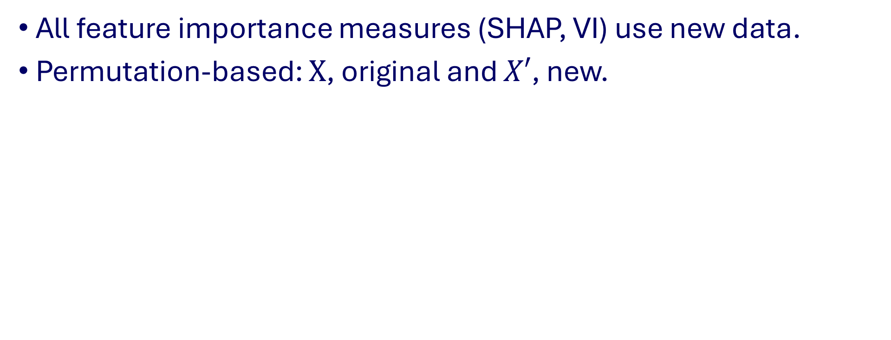
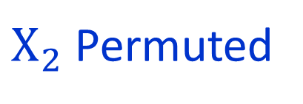
Extrapolation and Impossible Data
All feature importance measures (SHAP, VI) use new data.
Permutation-based: $X$, original and $X′$, new.
$X_{2}$ Permuted
’
New points may be unlikely or impossible data!
E.g., retired babies…

Slide 8
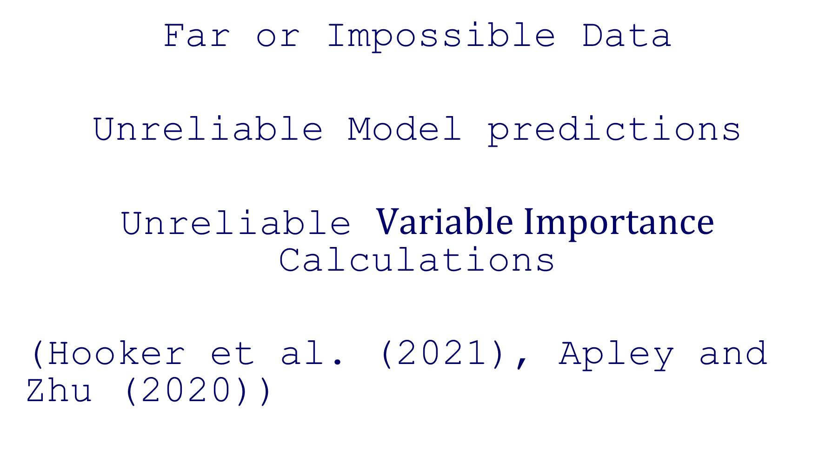
Far or Impossible Data
Unreliable Model predictions
Unreliable $Variable Importance$ Calculations
(Hooker et al. (2021), Apley and Zhu (2020))

Slide 9
Two New Designs
To restrict permutations!

Slide 10
First idea: GCMR
Permute only the variable’s unique information
Conditional Model Reliance + Gaussian Transformation
Permute only quantiles – always within range!

Slide 11
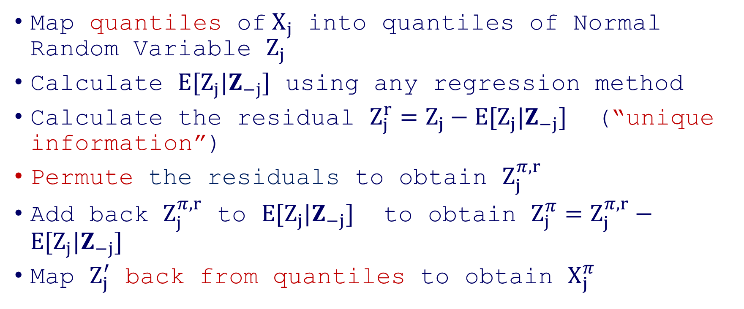
The GCMR Algorithm
Map quantiles of$X_{j}$ into quantiles of Normal Random Variable $Z_{j}$
Calculate $E[Z_{j}|Z_{−j}]$ using any regression method
Calculate the residual $Z_{j}^{r}=Z_{j}−E[Z_{j}|Z_{−j}]$ (“unique information”)
Permute the residuals to obtain $Z_{j}^{π, r}$
Add back $Z_{j}^{π, r}$ to $E[Z_{j}|Z_{−j}]$ to obtain $Z_{j}^{π}=Z_{j}^{π, r}−E[Z_{j}|Z_{−j}]$
Map $Z_{j}^{′}$ back from quantiles to obtain $X_{j}^{π}$

Slide 12
Step 1: Map quantiles of$X_{j}$ into quantiles of Normal Random Variable $Z_{j}$
Notes:
Triangular marginals correlated by a Gaussian Copula, mapped into normal

Slide 13

2: Non-Parametric Regression
$$E[Z_j|Z_{−j}]$$
3: Calculate Residuals

Slide 14
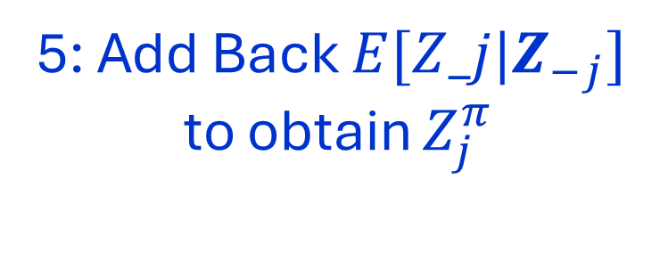
4: Permute Residuals
5: Add Back $E[Z_j|Z_{−j}]$
to obtain $Z_{j}^{π}$

Slide 15
5’: Permuted Gaussian
6: Map Back

Slide 17
GCMR Design: An Example
“Within Distribution”
Original Data (X)
New Data (X’)
Far

Slide 18
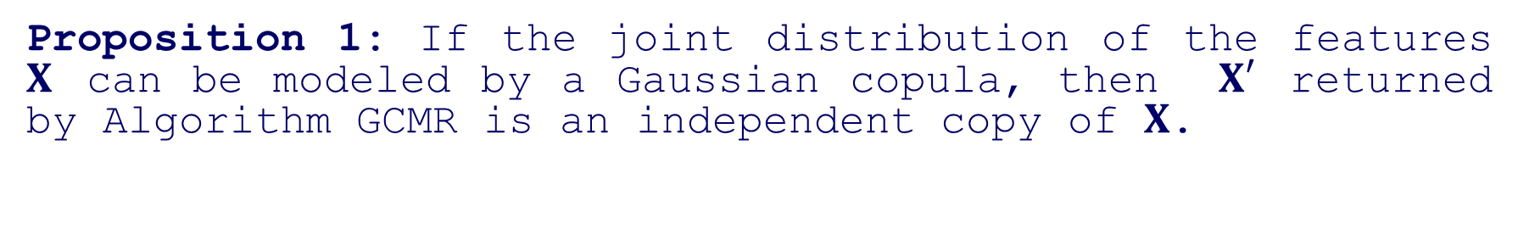
Theoretical Guarantee
Proposition 1: If the joint distribution of the features $X$ can be modeled by a Gaussian copula, then $X′$ returned by Algorithm GCMR is an independent copy of $X$.

Slide 19
GKnock
Knockoffs+ Gaussian Transformation
Replicates within Distribution – always within range!
Second idea: Knockoffs + Gaussian transformation
Permute only quantiles – always within range!

Slide 20
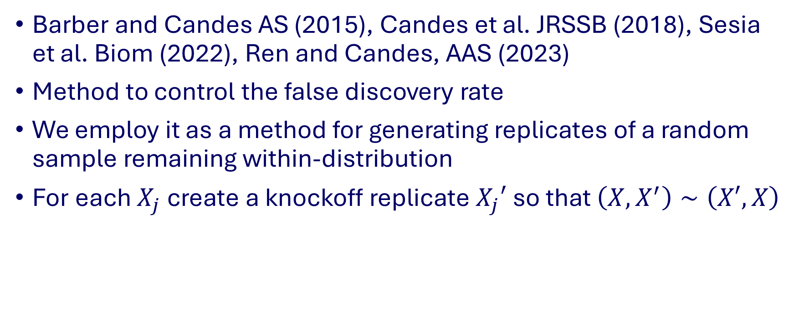
Knockoffs
Barber and Candes AS (2015), Candes et al. JRSSB (2018), Sesia et al. Biom (2022), Ren and Candes, AAS (2023)
Method to control the false discovery rate
We employ it as a method for generating replicates of a random sample remaining within-distribution
For each $X_{j}$ create a knockoff replicate $X_{j}′$ so that $\left(X,X^{′}\right)∼\left(X′,X\right)$

Slide 21
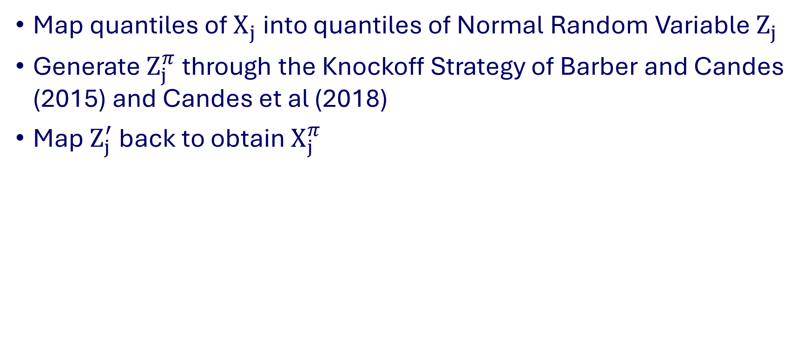
The GKnock Algorithm
Map quantiles of$X_{j}$ into quantiles of Normal Random Variable $Z_{j}$
Generate $Z_{j}^{π}$ through the Knockoff Strategy of Barber and Candes (2015) and Candes et al (2018)
Map $Z_{j}^{′}$ back to obtain $X_{j}^{π}$

Slide 22
Original Data
Within Distribut.
New Data (X’)
Impossible
Far
Notes:
Here let us recall to say that if we did not use the transformation, the knockoffs by themselves would not work. We “save” the knockoffs placing them in the “normal” world, where they work!

Slide 23
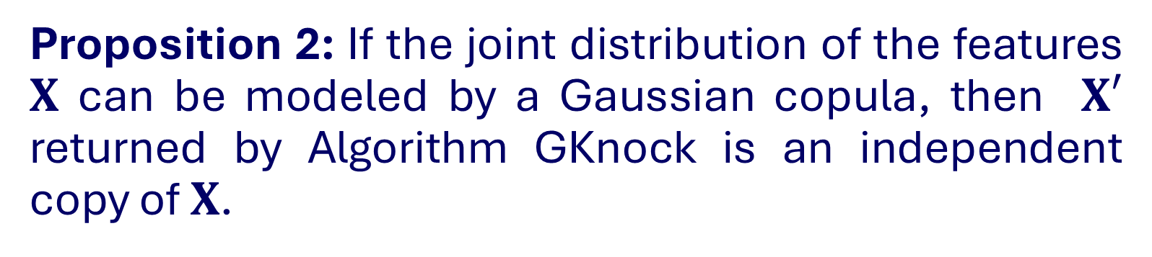
Theoretical Guarantee
Proposition 2: If the joint distribution of the features $X$ can be modeled by a Gaussian copula, then $X′$ returned by Algorithm GKnock is an independent copy of $X$.

Slide 24

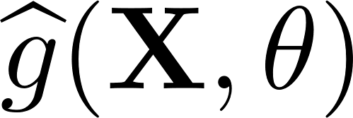
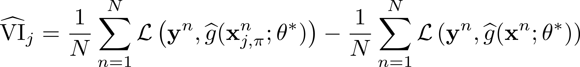
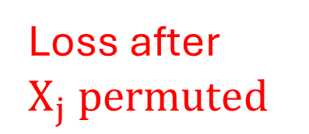
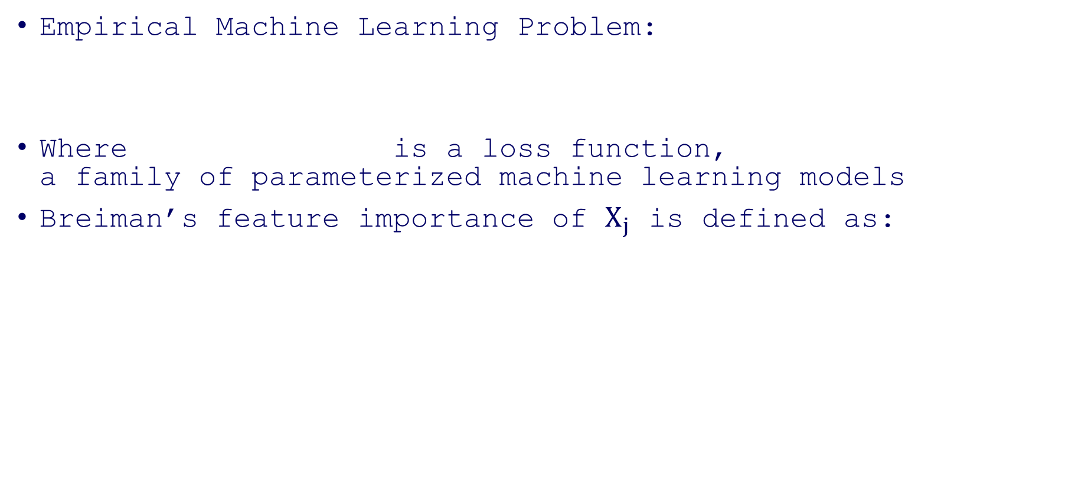
Permutation Variable Importance
Empirical Machine Learning Problem:
Where is a loss function, a family of parameterized machine learning models
Breiman’s feature importance of $X_{j}$ is defined as:
Loss after $X_{j} permuted$
Original Loss

Slide 25
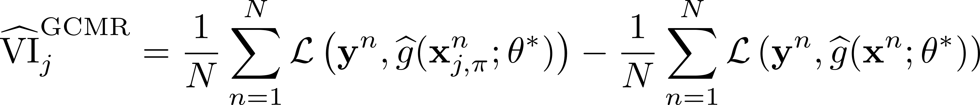
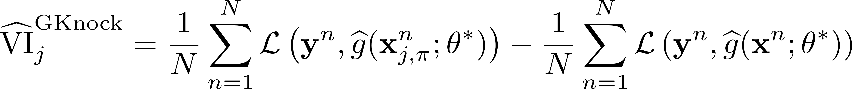
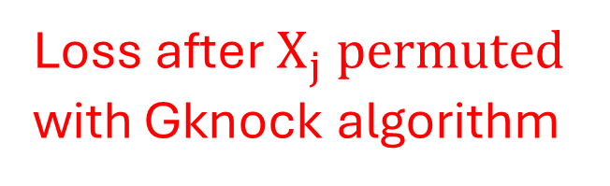
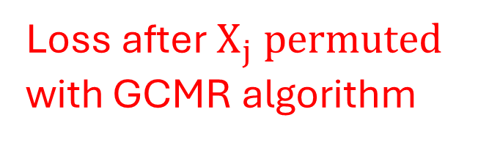
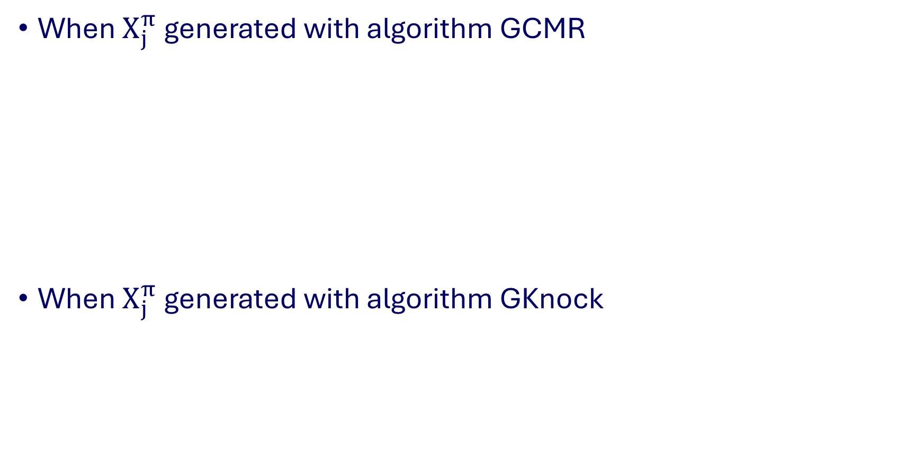
New Permutation Importance Measures
When $X_{j}^{π}$ generated with algorithm GCMR
When $X_{j}^{π}$ generated with algorithm GKnock
Loss after $X_{j} permuted$
with GCMR algorithm
Original Loss
Loss after $X_{j} permuted$
with Gknock algorithm
Original Loss

Slide 26
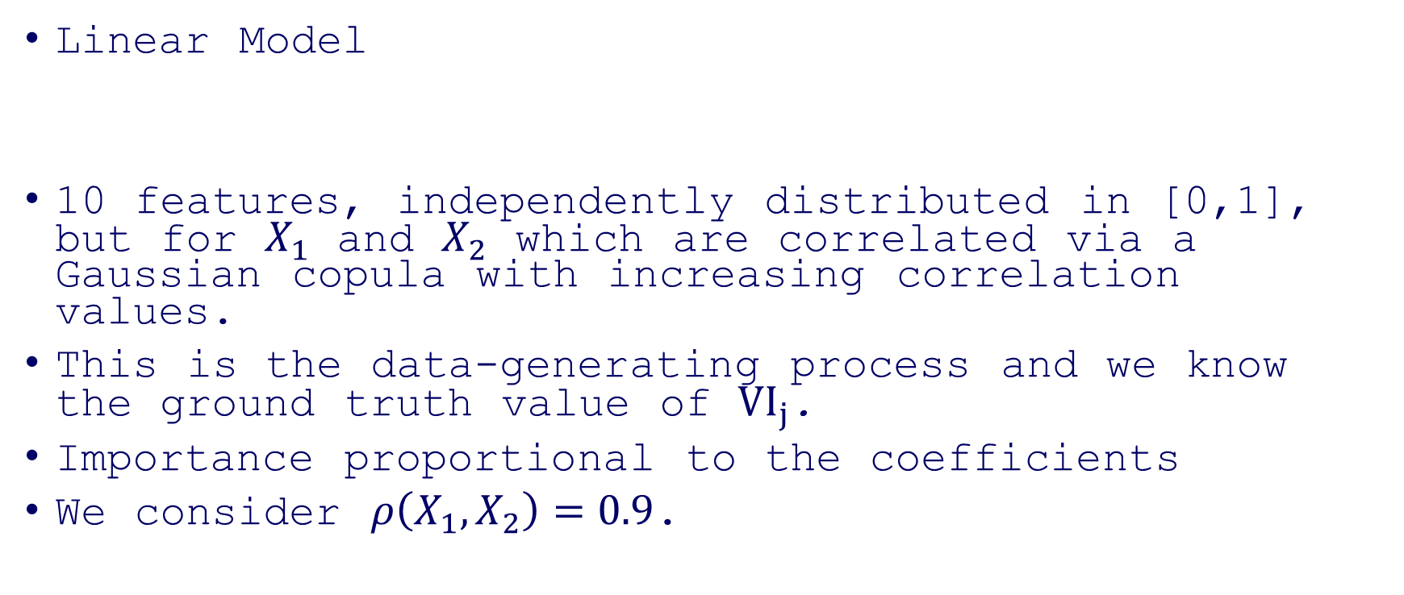
Test Case: Hooker et al. (2020)
Linear Model
10 features, independently distributed in [0,1], but for $X_{1}$ and $X_{2}$ which are correlated via a Gaussian copula with increasing correlation values.
This is the data-generating process and we know the ground truth value of $VI_{j}$.
Importance proportional to the coefficients
We consider $ρ\left(X_{1},X_{2}\right)=0.9$.

Slide 27
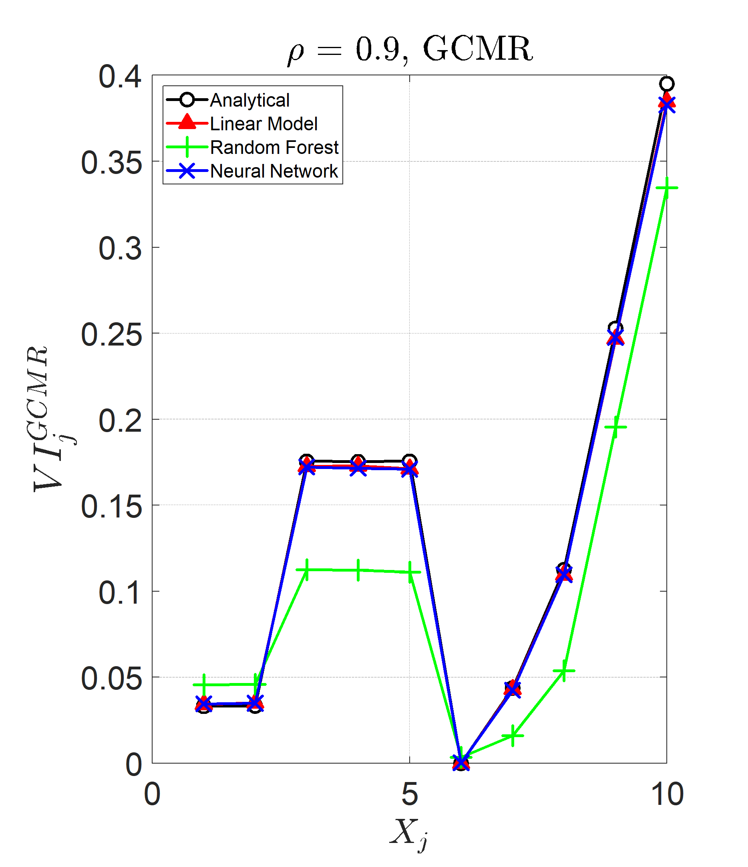
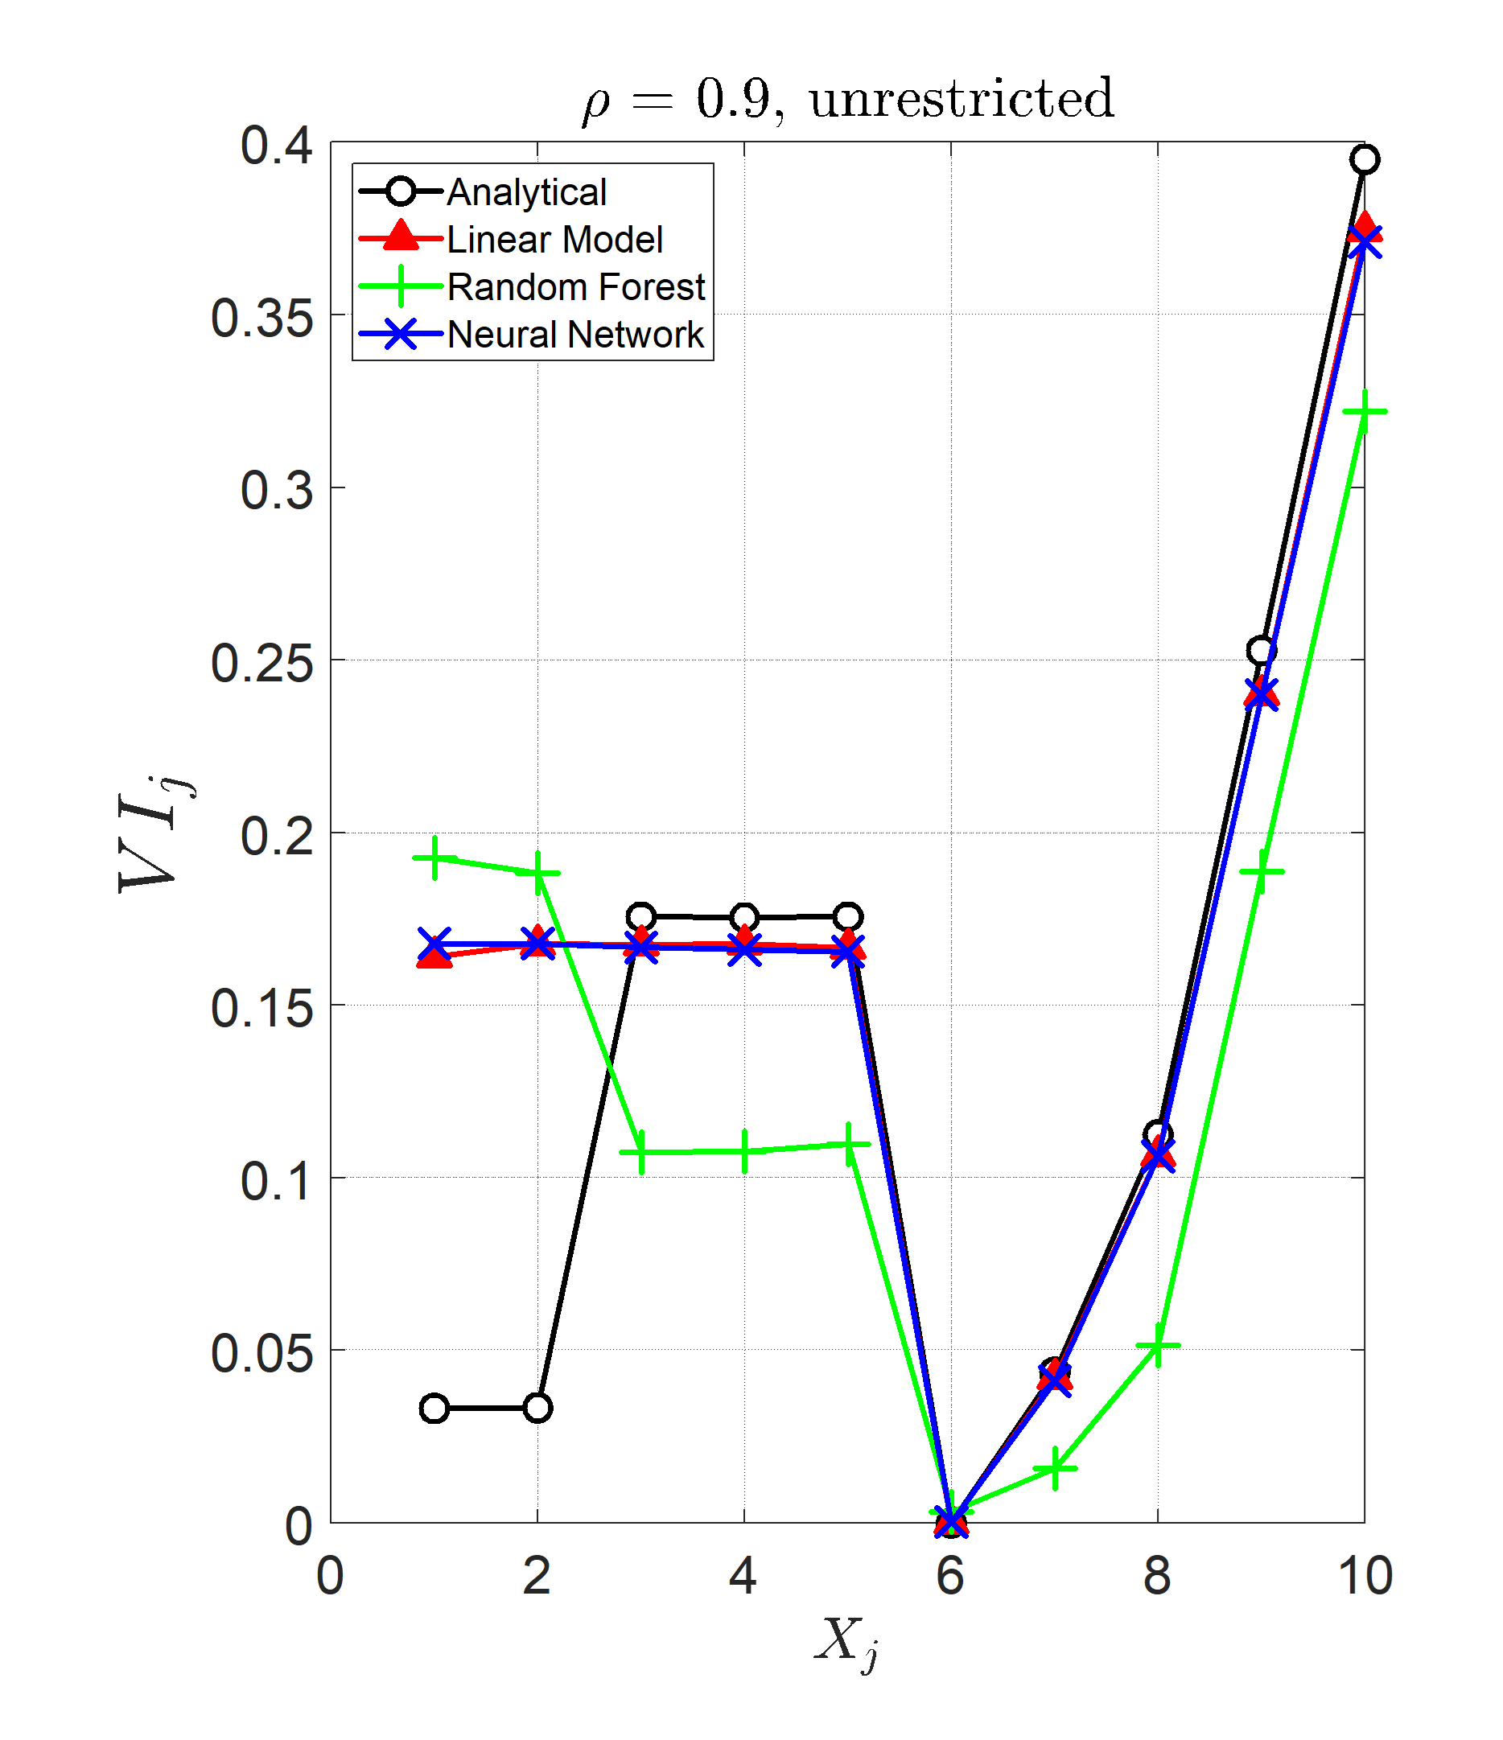
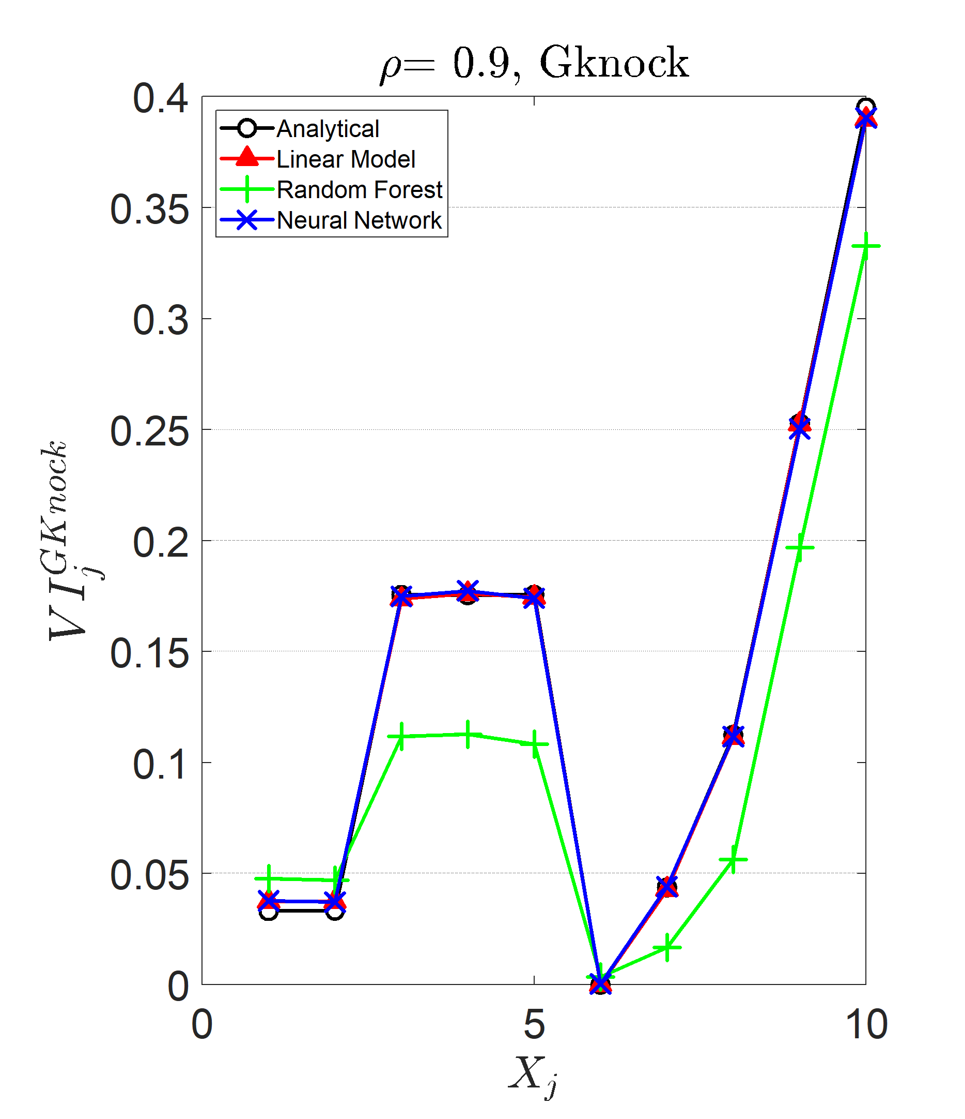
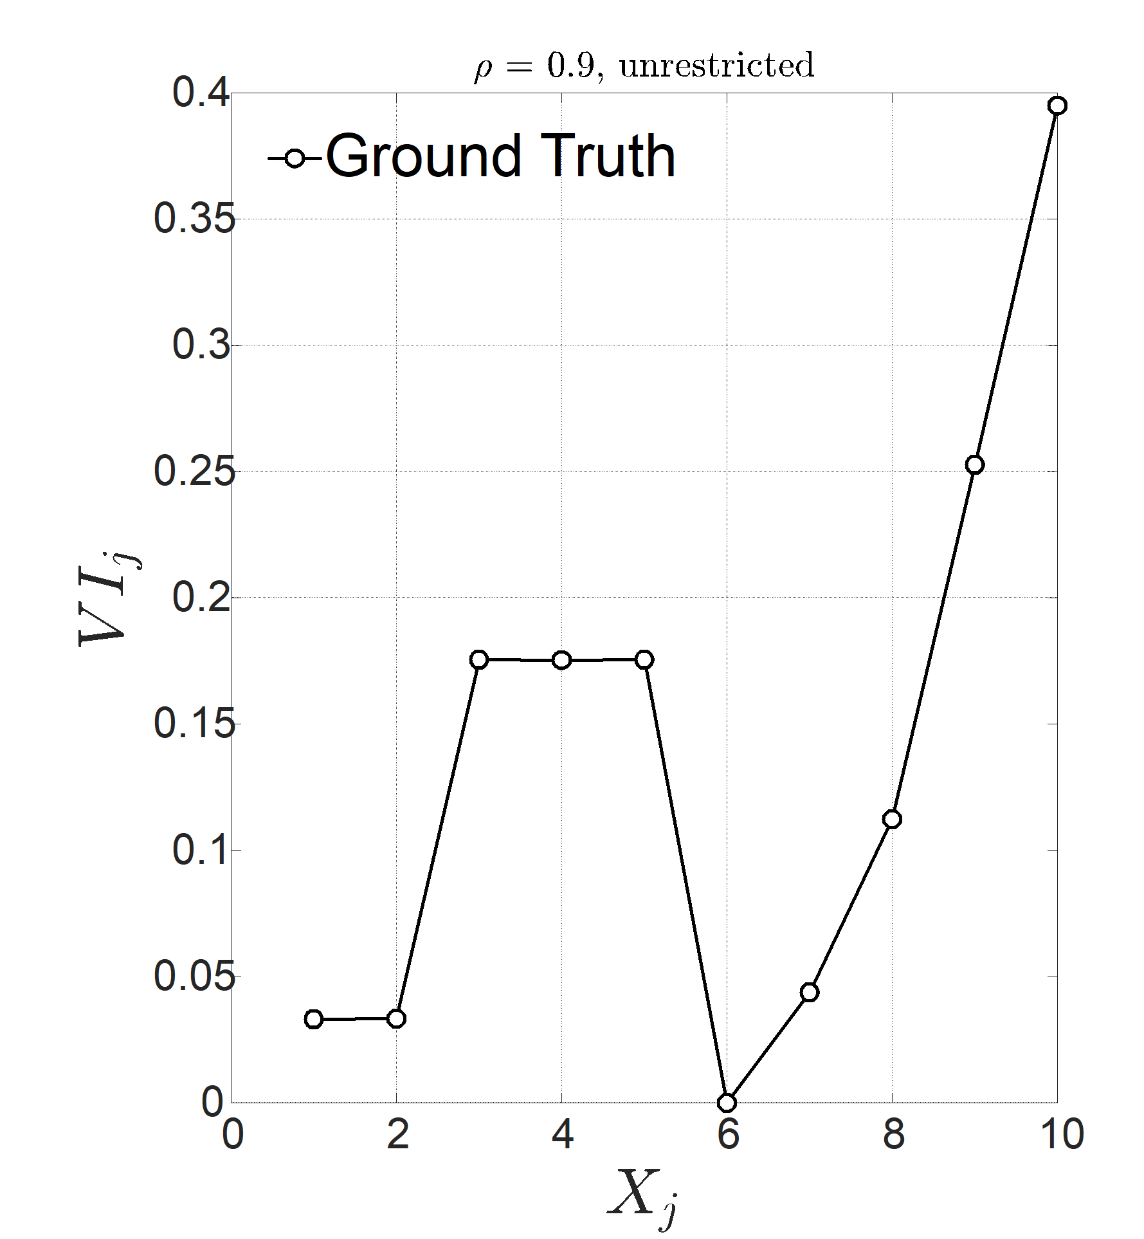

Unrestricted Permutations (${VI}_{j})$
VI Estimate
too High!
VI Estimate
correct!
Ground Truth

Slide 28
Why?
Under quadratic loss VI is (surprisingly) a total index
Total indices are an important class of measures of statistical association
Without permutation restrictions you go “out of distribution”
Our VI’s remain “within distribution”

Slide 29
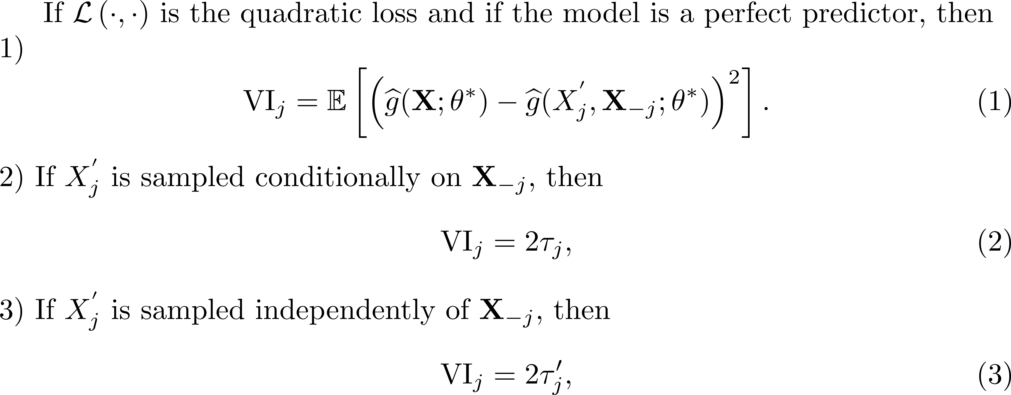
The Mathematical Link
Classical Total index
Verdinelli and Wasserman
index

Slide 30
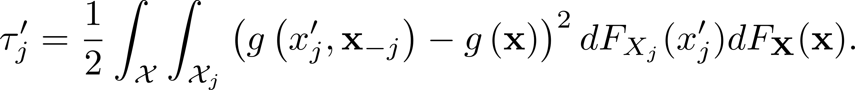
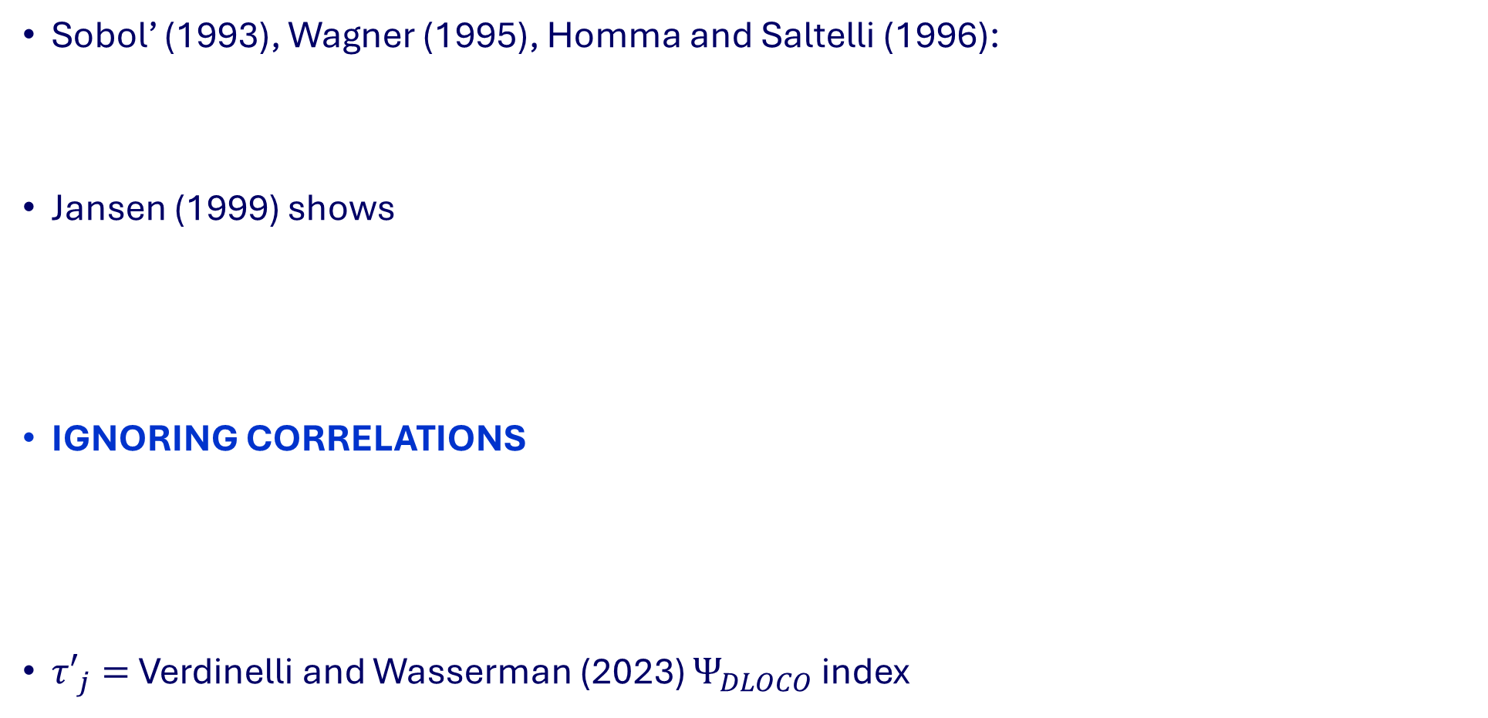
What are Total Indices?
Sobol’ (1993), Wagner (1995), Homma and Saltelli (1996):
Jansen (1999) shows
IGNORING CORRELATIONS
${τ′}_{j}=$ Verdinelli and Wasserman (2023) $Ψ_{DLOCO}$ index
Within Distribution
Out of Distribution!

Slide 31
Boston Housing

Slide 32
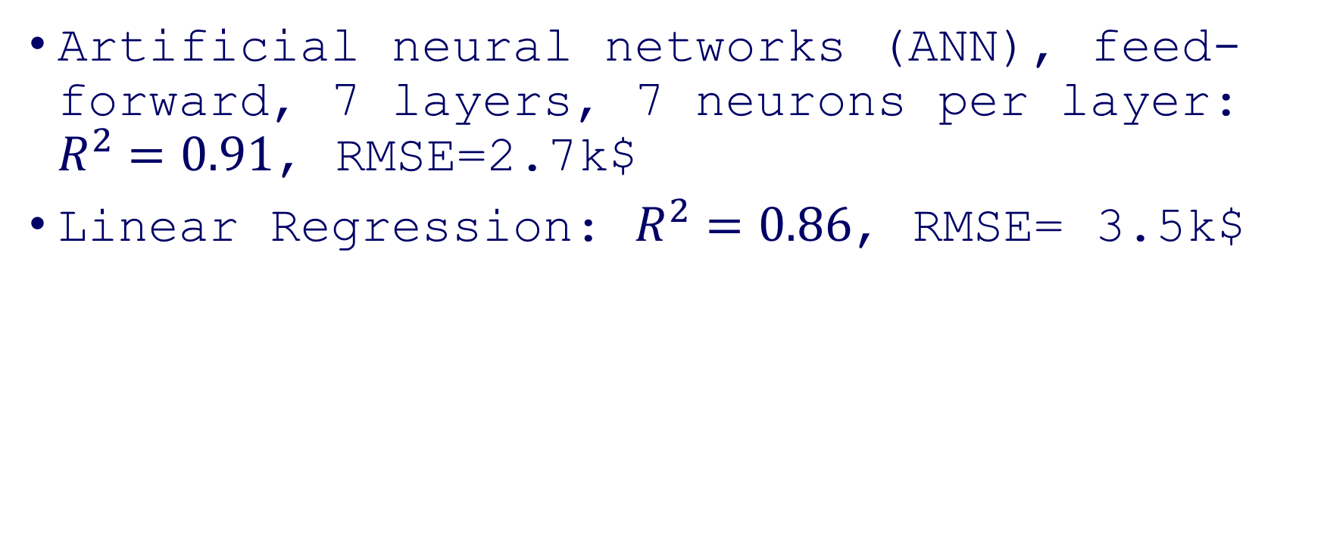
Three Machine Learning Models
Artificial neural networks (ANN), feed-forward, 7 layers, 7 neurons per layer: $R^{2}=0.91$, RMSE=2.7k$
Linear Regression: $R^{2}=0.86$, RMSE= 3.5k$

Slide 33
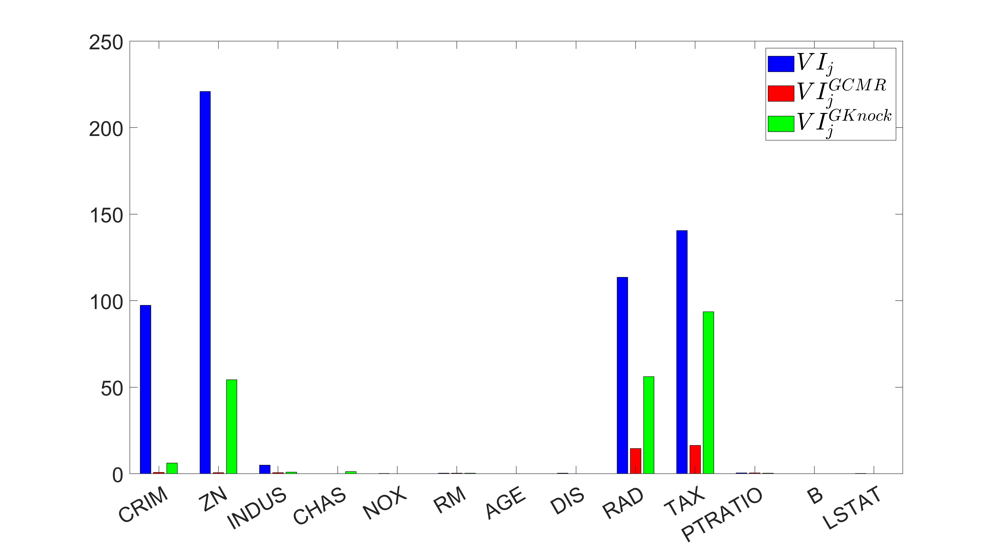

Linear Regression, $VI_{j}$ , $VI_{j}^{GCMR}$ and $VI_{j}^{GKnock}$

Slide 34
Implied Model Predictions
Long tail of unreliable predictions
(strong extrapolation!)
No more tail:
Within distribution

Slide 35
The SHAPs
Wrong importance attribution due to extrapolation

Slide 36

Neural Network, $VI_{j}$ , $VI_{j}^{GCMR}$ and $VI_{j}^{GKnock}$

Slide 37
Name Ethinicity
The Dataset:
Primary dataset for name-based ethnicity classification, very much used in works on fairness
13 Million entries, 4 ethnicities: Asian 1.9%, Black 14.2%, Hispanic 16.7%, and White 67.1%.
Jain et al (2022) extract 30 meaningful features on the dataset and use Multinomial Logistic Regression for prediction.
ML Model in this work: Neural Network
Variable importance
SHAPs not computationally feasible
Permutation-based importance measures require just a few minutes

Slide 38

${VI}_{j}$ unrestricted: results

Slide 39

${VI}_{j}^{GCMR}$: Ranking for the ANN

Slide 40
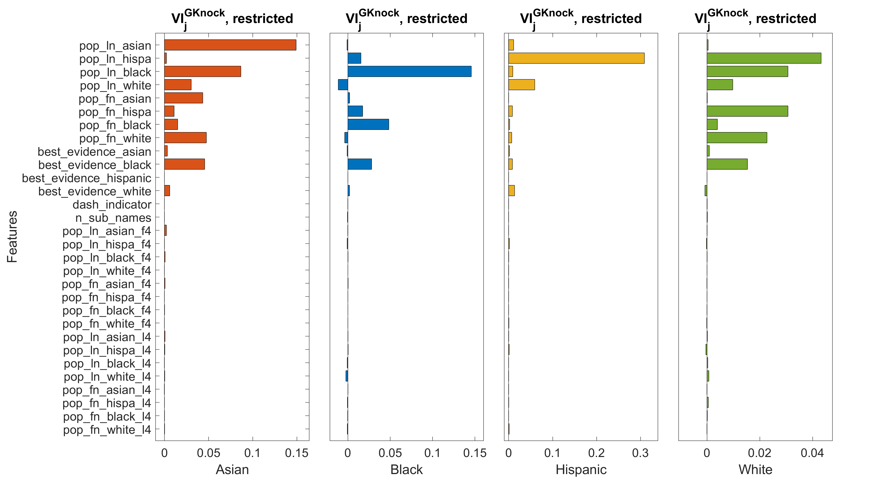

${VI}_{j}^{GKnock}$: Ranking for the ANN

Slide 41
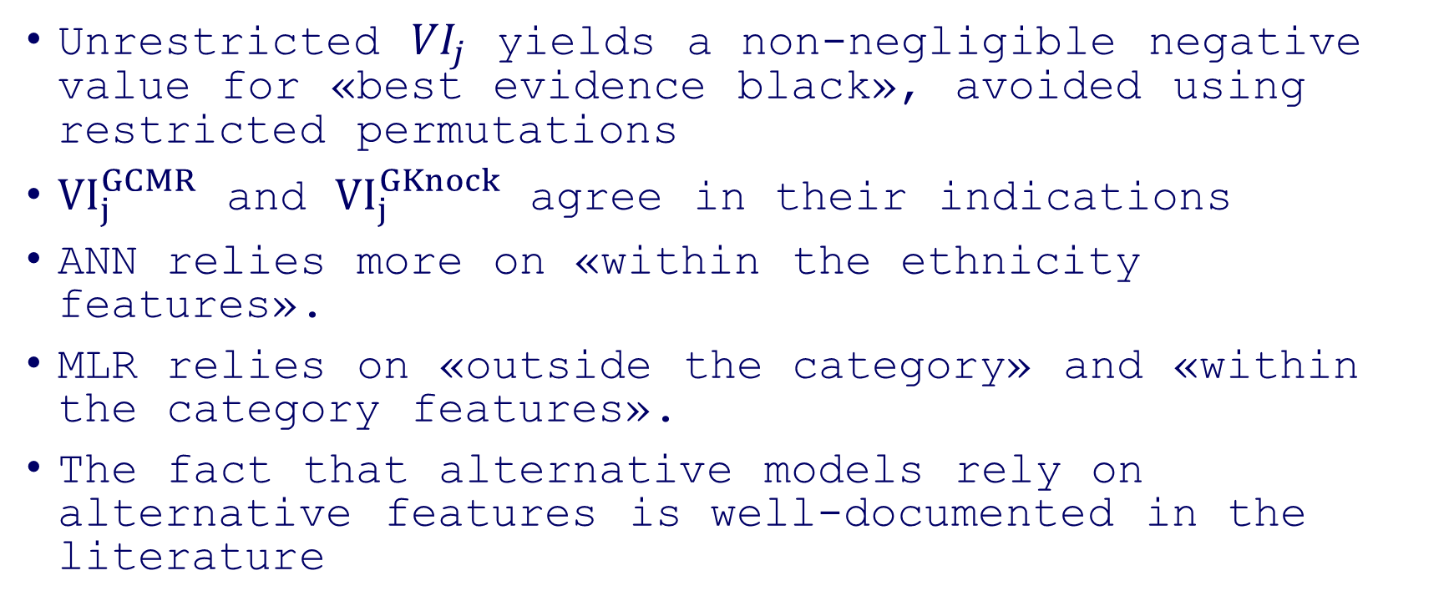
Summary for Ethnicity
Unrestricted ${VI}_{j}$ yields a non-negligible negative value for «best evidence black», avoided using restricted permutations
${VI}_{j}^{GCMR}$ and ${VI}_{j}^{GKnock}$ agree in their indications
ANN relies more on «within the ethnicity features».
MLR relies on «outside the category» and «within the category features».
The fact that alternative models rely on alternative features is well-documented in the literature

Slide 42
Final Remarks
Variable importance is key for explainability
Three new strategies (presented 2) for reducing extrapolation
Theoretical guarantees
The resulting VI measures have a direct interpretation in terms of Total Indices
Easy to implement
Computationally convenient (avoid retraining)
Computational Experiments:
Effective in eliminating long tails
Stable: Yield similar indicators (important when there is no ground truth available)
Tractable: run on large datasets

Slide 43
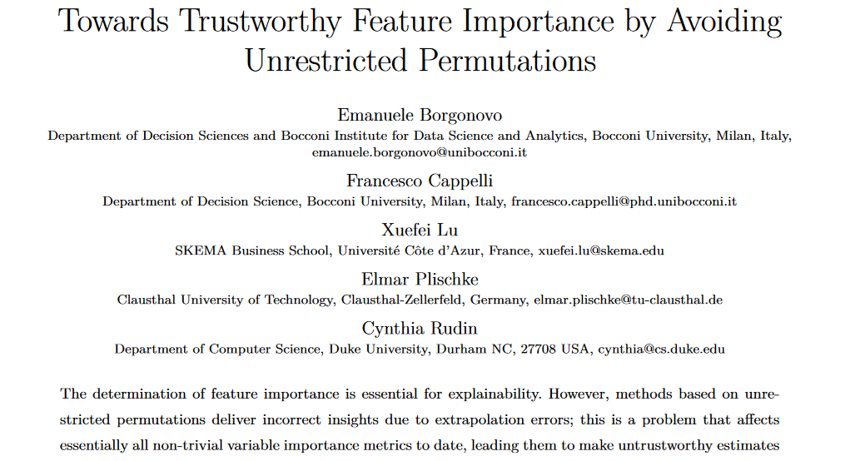
Thank you!
Available at: https://github.com/emanueleborgonovo/TrustworthyFeatureImportanceMeasures

